Slide 1
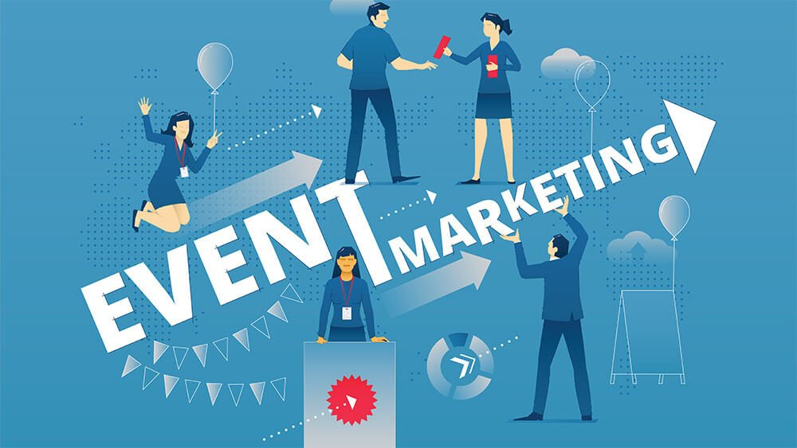

NEW TRENDS IN MARKETING
SUBMITTED BY :
Mrinal Joshi (221028)
Neelansh Chaturvedi (221030)
SUBMITTED TO :
Meghna Verma ma'am

Slide 2
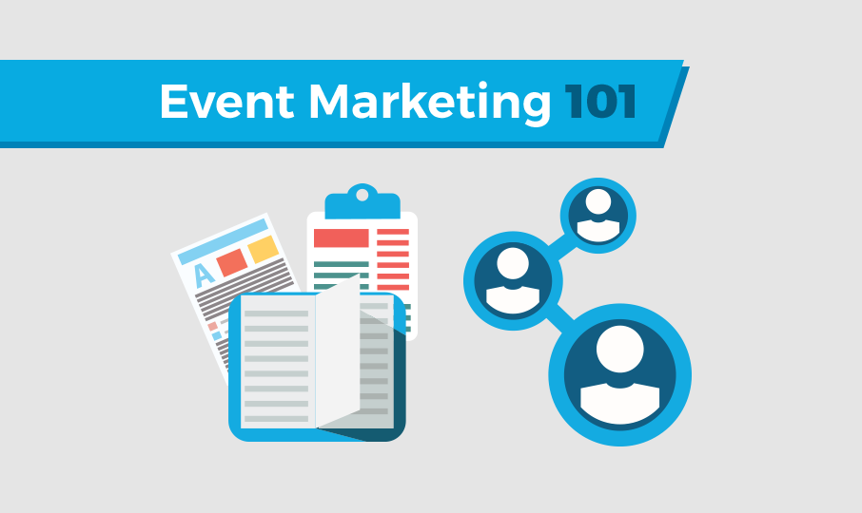
Event Marketing
Definition:
Event marketing is a strategy marketers use to promote their brand, product, or service with an in-person or real-time engagement. Events can be online or offline, and companies can participate as hosts, co-hosts, participants or sponsors. Whether online or in-person, event marketing is the ultimate way to connect with your audience, showcase your brand, and drive results.

Slide 3
Eight Companies Promoting Event marketing

Slide 4

1. User Conference: Oracle Code One (JavaOne)
User conferences are a formal gathering of thought leaders, industry influencers, and industry titans. They often revolve around one or two themes within an industry. Attendees should expect activities like special guest lecturers and breakout networking sessions.
At Oracle Code One (formerly known as JavaOne and called CloudWorld in 2022), programmers from all over the world participated in this environmentally conscious event. As part of its “green” initiative, Code One added a plant-conscious menu, carbon footprint reduction lessons, and the option for attendees to donate food to charity. As you can see, conferences can perform double duty to promote brand values in exciting and engaging ways.

Slide 5
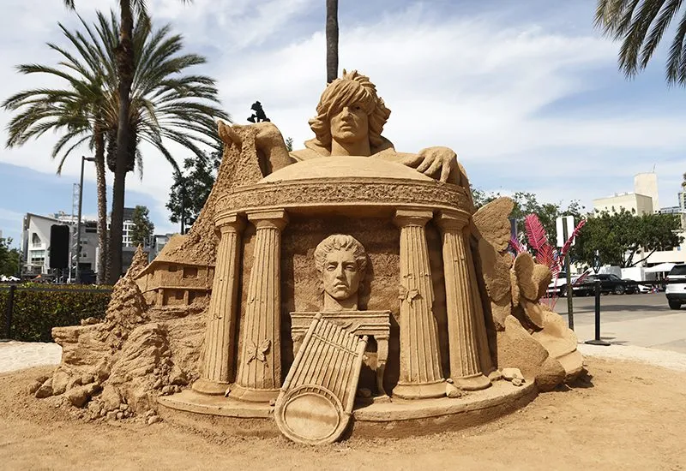
2. Experiential Activation: Audible Beach at SDCC
Experiential activations are ongoing installations that allow viewers to participate in or observe an activity that represents a brand. This type of event often involves a shocking or extremely memorable image like the one you’ll see in our example.
At 2022 Comic-Con International (aka San Diego Comic-Con or SDCC), Audible brought Impact Winter and The Sandman to life alongside the launch of Moriarty: The Devil’s Game, working with Civic Entertainment Group to build massive sand sculptures from 150 tons of compacted sand. Fans sat on the beach, sampled Audible Originals, took photos with the sculptures, and recharged in Audible-branded beach chairs.

Slide 6
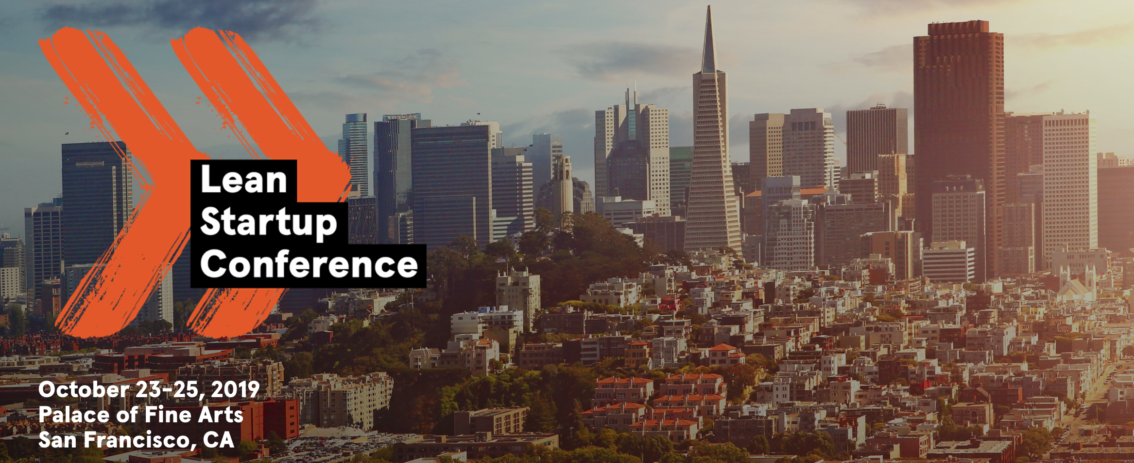
3. Networking Event: Lean Startup’s Networking Event
Networking events bring groups of people together for assisted opportunities to form connections. Events can be as formal or informal as they reflect the host’s brand. Face-to-face meetings have become increasingly sought after in our growing digital world, making this type of event more and more popular.
At Lean Startup’s most recent conference, they offered inspiring networking events (like an evening at Mob Museum) to promote higher-quality guest interactions. Lean Startup’s immersive networking opportunities used the global community as its central theme. They also offered a frequently updated public guest list to prove that attendees would find like-minded individuals when they arrived.

Slide 7
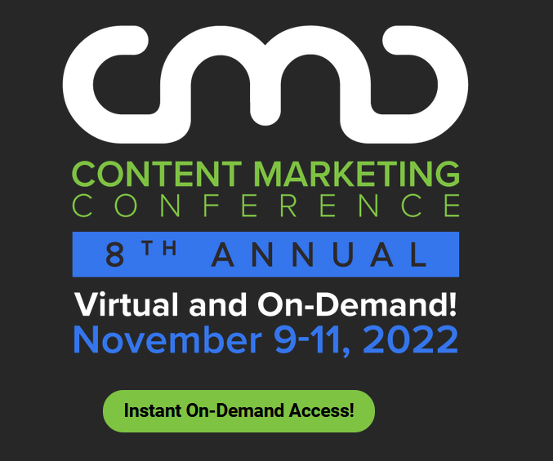
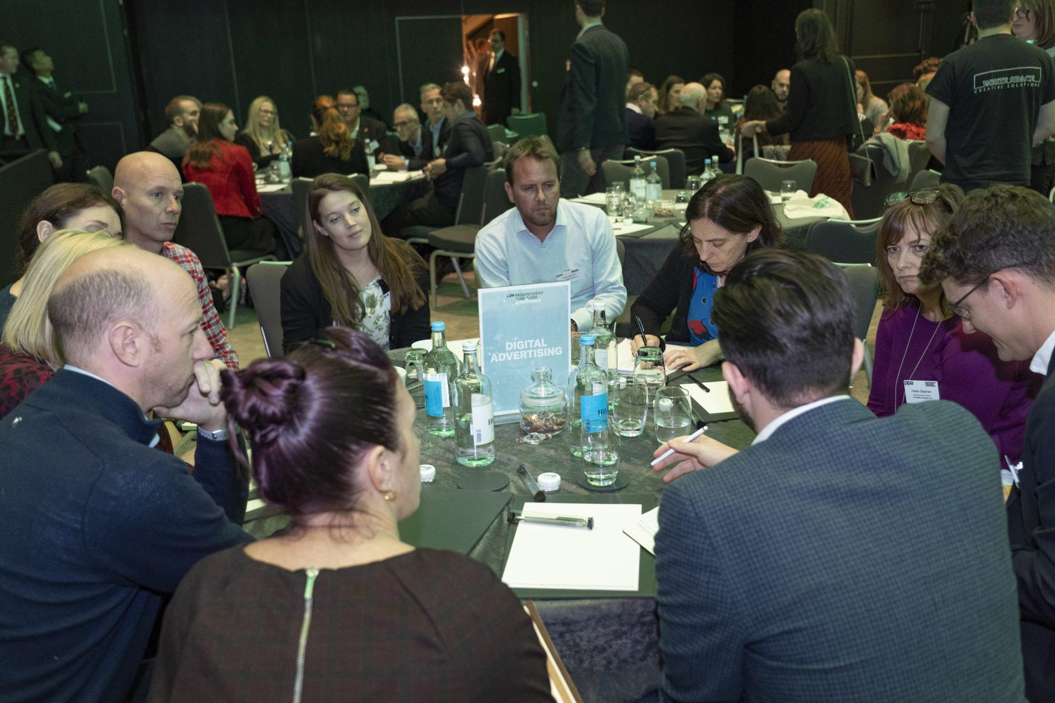
4. Publisher Conference: Content Marketing Institute’s Sales Acceleration Event
Whereas user conferences focus on engaging customers, nurturing prospects, and building thought leadership — publisher conferences are revenue drivers for media companies. They often bring together a wide community of readers, provide vast educational sessions, and are bolstered by partnerships.
Content Marketing Institute’s annual publisher conference, Content Marketing World, has a different theme each year. Because this event type is critical to brand perception among potential customers, CMI made sure to run their theme ideas by the PR team, operations department, and the entire events team to make sure they aligned with their goals. Themes can be quirky if they make sense with the event’s purpose.

Slide 8
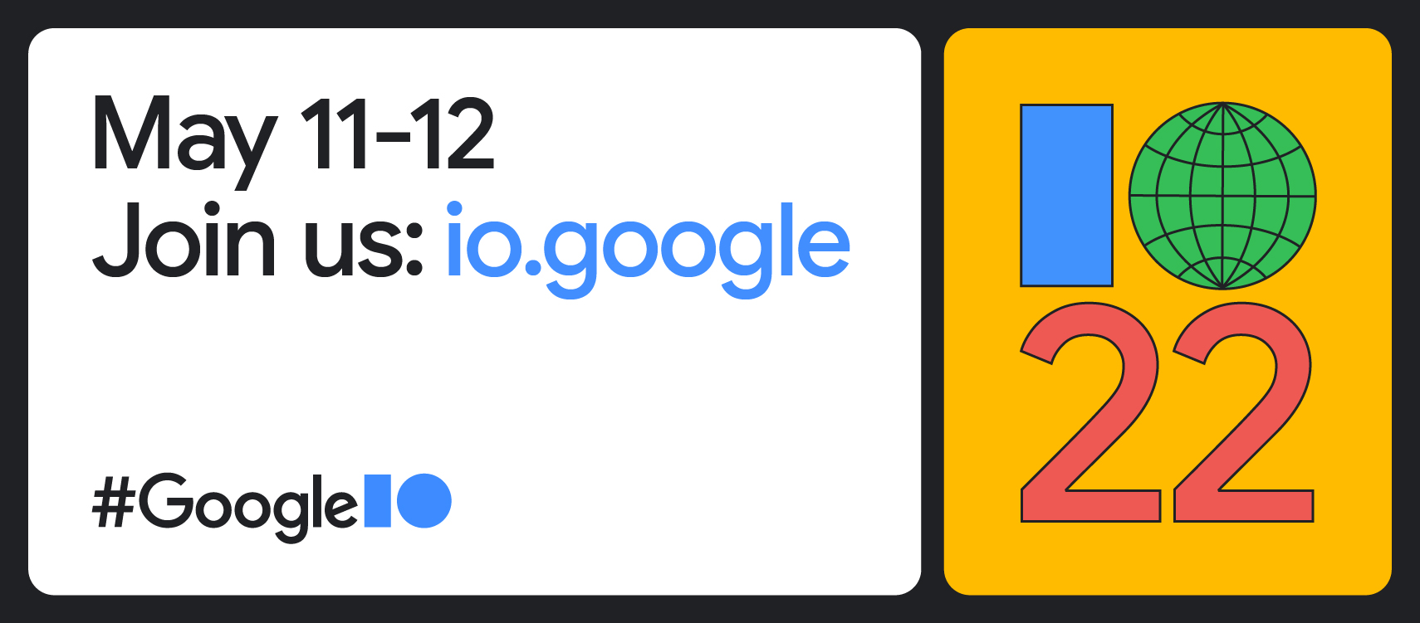
5. Virtual Event: Google I/O
At Google I/O, organizers used a 360-degree camera to record keynote speeches so virtual attendees could watch live from all over the world. They even hosted the videos on YouTube, making the whole experience free and easy to access. While the conference was a living, breathing in-person event, the option to attend virtually provided those unable to attend with a taste of the experience.

Slide 9

6. Seminar: SQLBits
Seminars are educational events or focused training sessions given on a specific topic. These are often hosted by industry thought leaders (or those looking to secure their status as such).
At SQLBits, data platforms reigned supreme, and attendees were eager to deepen their knowledge of cutting-edge technologies they otherwise wouldn’t have access to. Their highlights include a guarantee of over 10 hours of training per attendee with more than 150 specialist sessions that provide a deep dive into the material. Any hands-on or experiential product launch would also work nicely for this event type.

Slide 10
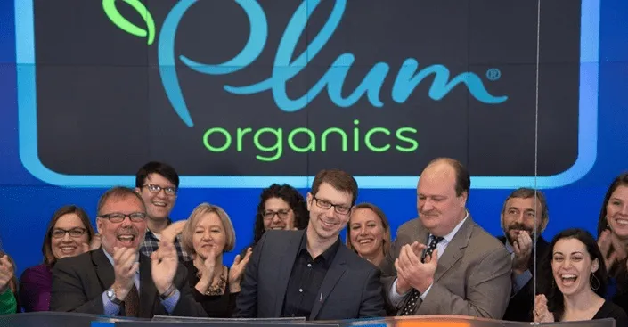
7. Internal Company Meeting: Plum Organics’ Coloring Book Meetings
Internal company meetings are informational updates or check-in sessions amongst company employees. They can involve the entire staff or select teams. Topics range from weekly check-ins to project work groups.
In keeping with their child-friendly branding, Plum Organics inspires the kid in all of their employees by encouraging them to color with crayons and markers during their internal company meetings. During these creative brainstorming sessions, staff members get a chance to color, talk, and decompress. This example proves that company meetings can be entertaining just by adding a simple activity to mix things up.

Slide 11
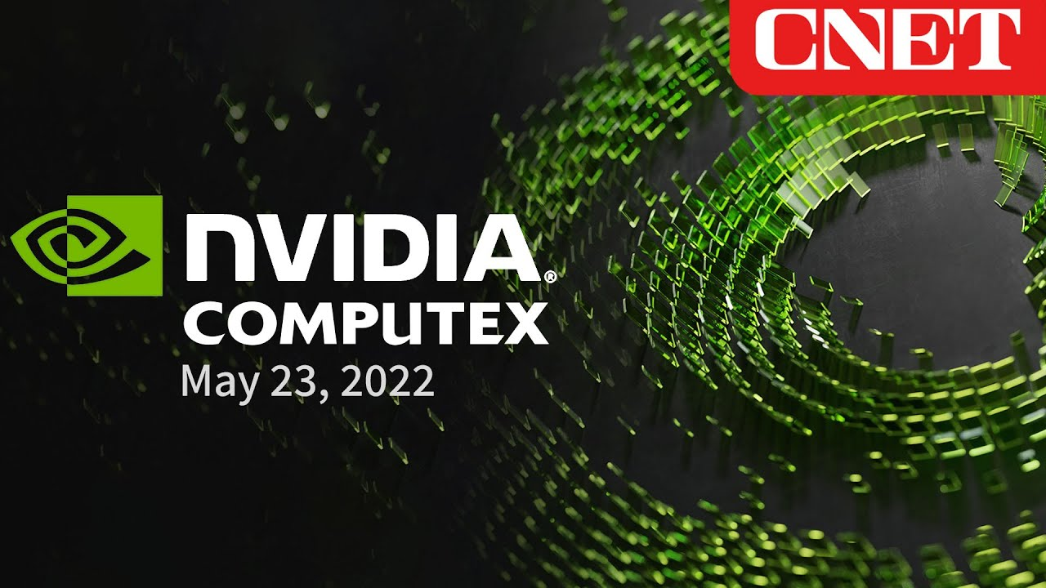
8. Trade Show: CNET’s Computex
Trade shows are an opportunity for exhibitors to showcase their products and services. They are usually hosted under a single industry theme. Usually, attendees are contractually obligated to spend a certain amount of money on products and services at the conference — providing an incentive for organizations to brave the price of exhibiting.
At Computex, CNET gave companies like Intel the chance to demonstrate their latest hologram project during a keynote speech. High-profile guests with products farther along in their fields make excellent headliners for this event type. Even if your company is not involved in technology, trade shows can be used to display what’s currently trending in your industry.

Slide 12
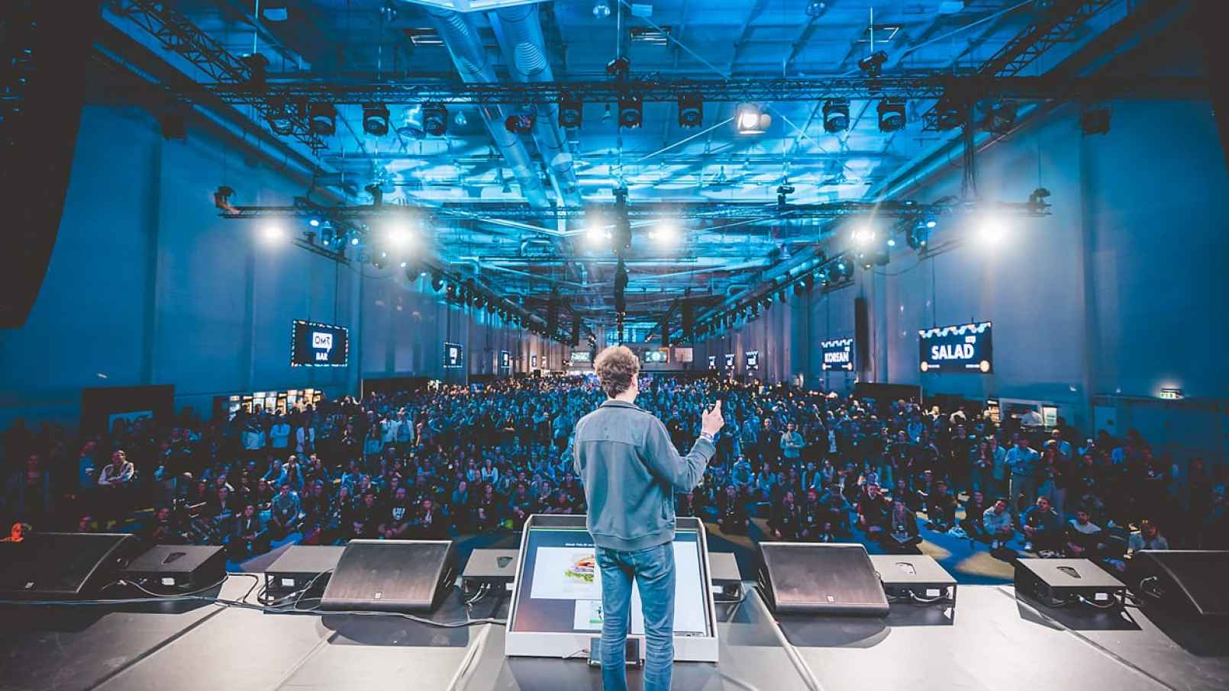
THANK YOU

